Slide 1
Sales and Finance Analytics
Driving Business Decisions Through Data Precision
Presented by : Dhanshree Kharat

Slide 2
Company overview
Problem Statement
Data Sources
Tools & Techniques
Formulas & Functions
Sales & Finance report
Project Outcomes
Agenda

Slide 3
Company Overview
AtliQ Hardware stands as a prominent global provider of cutting-edge computer hardware and peripherals. Operating across APAC, Europe, and North America, the company delivers tailored solutions through a strong presence in both physical retail and online marketplaces. Its multi-channel strategy—covering retail outlets, direct sales, and distribution partners—supports various divisions including Networking & Storage, PC Components, and Peripherals & Accessories.

Slide 4
Problem Statement
AtliQ Hardware is currently facing challenges related to shrinking profit margins and overall financial instability. The absence of an integrated analytics framework has made it difficult to make informed decisions across sales operations and financial management. To address this, there's a critical need for a robust, Excel-based analytical solution that provides clear insights into sales performance and financial well-being—empowering data-driven strategies to counteract the downward trends.

Slide 5
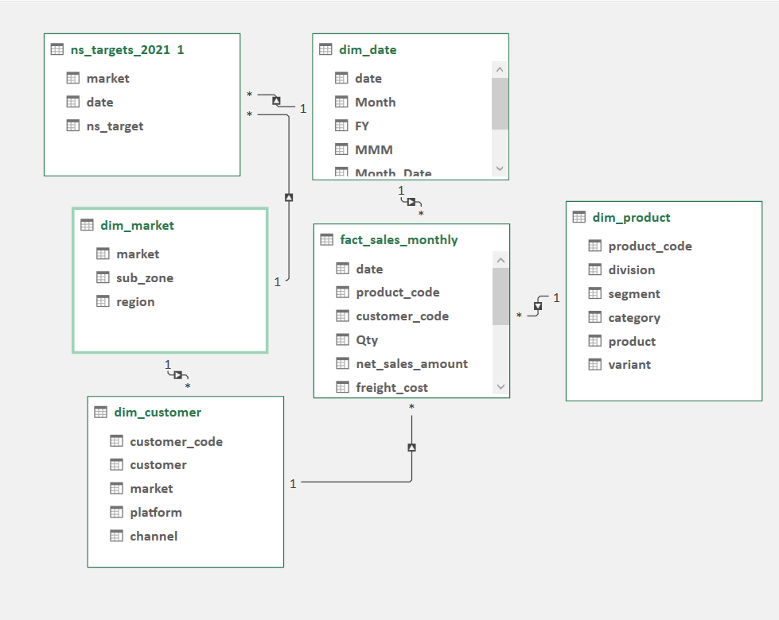
Data Sources
AtliQ Hardware provided five key CSV files—fact_sales monthly, dim_market, dim_customer, dim_product, and ns_targets_2021. Leveraging these datasets, I developed a comprehensive data model that forms the foundation for strategic sales and finance reporting, driving informed decision-making and enhanced business outcomes.

Slide 6
Excel Features Used
Utilized the 'Get Data' feature to extract information from CSV files, followed by data cleaning and transformation using Power Query and M language. A custom date table was created to calculate fiscal years accurately. Power Pivot and DAX were employed for building the data model and defining key measures. Pivot Tables and Conditional Formatting were used to structure the report and visually highlight values falling below or exceeding defined thresholds. Finally, Pivot Charts and Slicers were incorporated to develop interactive and dynamic dashboards. This process follows the ETL (Extract, Transform, Load) approach for seamless data integration and reporting.

Slide 7
For Sales Analytics
For Finance Analytics
Metric | DAX Formula
2021 Target Achievement % | DIVIDE([Net Sales 21], [target 21], 0)
Target Gap (2021) | [Net Sales 21] - [target 21]
Growth % (2021 vs 2020) | DIVIDE([NetSales 21] - [NetSales 20], [NetSales 20], 0)
Total Net Sales | SUM([net_sales_amount])
Net Sales FY 2019 | CALCULATE([Net Sales], dim_date[FY] = "2019")
Net Sales FY 2020 | CALCULATE([Net Sales], dim_date[FY] = "2020")
Net Sales FY 2021 | CALCULATE([Net Sales], dim_date[FY] = "2021")
Total Target for 2021 | SUM(ns_targets_2021[ns_target])
Metric | DAX Formula
2021 Target Achievement % | DIVIDE([NetSales 21], [target 21], 0)
Target Gap (2021) | [NetSales 21] - [target 21]
Sales Growth (2021 vs 2020) | DIVIDE([NetSales 21], [NetSales 20], 0)
Total COGS | SUM(fact_sales_monthly[total_cogs])
Gross Margin | [Net Sales] - [COGS]
Gross Margin % (GM%) | DIVIDE([Gross Margin], [Net Sales], 0)
Total Net Sales | SUM([net_sales_amount])
Net Sales FY 2019 | CALCULATE([Net Sales], dim_date[FY] = "2019")
Net Sales FY 2020 | CALCULATE([Net Sales], dim_date[FY] = "2020")
Net Sales FY 2021 | CALCULATE([Net Sales], dim_date[FY] = "2021")
Total Target 2021 | SUM(ns_targets_2021[ns_target]

Slide 8
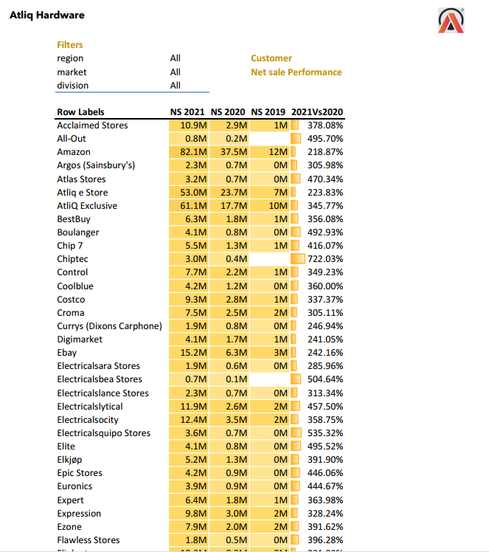
Sales Analytics Report key insights
Sales analysis is crucial for understanding business performance, identifying top-performing channels, and uncovering areas for growth or improvement.
It enables data-driven decisions that guide strategic planning and resource allocation.
AtliQ Hardware saw a remarkable 304.5% increase in net sales from 2020 to 2021, with major contributions from Amazon, AtliQ Exclusive, and AtliQ e-Store.
Emerging outlets like Nova and Integration Stores posted the highest growth percentages, highlighting strong expansion potential.
The company demonstrated balanced success across both retail and e-commerce channels, with reliable performance from key partners like Reliance Digital and Walmart

Slide 9
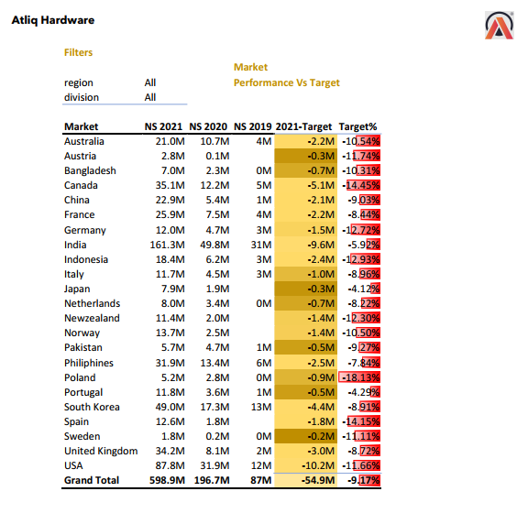
Market performance Vs Target key insights
Analyzing sales and market performance is essential for understanding how well business objectives are being met, identifying strong and weak markets, and guiding strategic decisions.
This analysis reveals that while overall net sales in 2021 reached 598.9M, showing strong year-over-year growth, the company still fell short of its 2021 sales target by 54.9M (−9.17%).
Major markets such as the USA, India, and Canada delivered high sales volumes but underperformed against their targets, highlighting the need for improved forecasting and execution.
Meanwhile, markets like Poland, Austria, and Indonesia showed significant shortfalls, suggesting a need for localized strategy reviews. Despite strong top-line growth, the gap between performance and targets underlines the importance of aligning sales strategies with realistic market potential

Slide 10
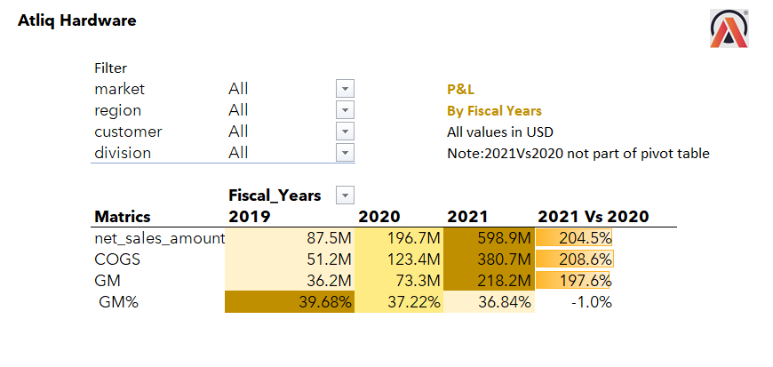
Financial performance key insights
Financial analysis is critical for evaluating profitability, cost efficiency, and long-term sustainability.
It provides clarity on revenue generation, cost control, and margin trends that guide strategic business decisions.
Between 2020 and 2021, AtliQ Hardware's net sales surged by 204.5%, reaching $598.9M, while COGS increased by 208.6%, indicating rising operational costs.
Despite this growth, gross margin (GM) improved significantly to $218.2M—a 197.6% increase. However, the gross margin percentage (GM%) slightly declined by 1%, reflecting pressure on profitability margins.
This highlights the need to manage costs effectively as sales scale up to maintain strong profit ratios

Slide 11
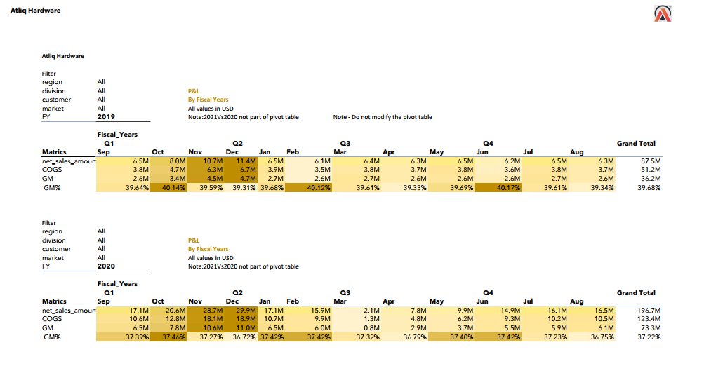
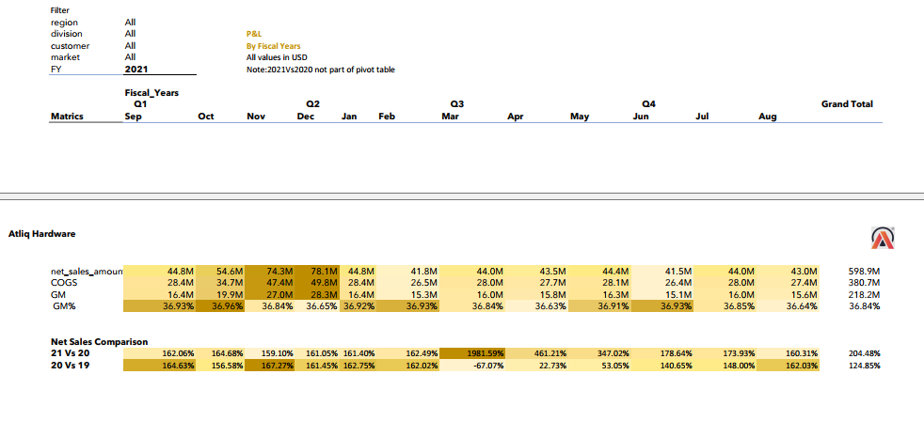
P & L by Fiscal Month Key Insights
This P&L analysis offers a year-wise breakdown of net sales, cost of goods sold (COGS), and gross margin (GM) for AtliQ Hardware.
It highlights a significant revenue surge of 204.5% in FY 2021 compared to FY 2020, indicating strong sales momentum.
COGS also increased by 208.6%, reflecting higher production or procurement costs. Despite this, gross margin (GM) rose nearly 198%, although the GM% dipped slightly by 1%, suggesting a tighter margin environment.
These insights are vital for understanding profitability trends and evaluating cost-efficiency, helping guide future strategic decisions.

Slide 12
Project Outcomes
Integrated Data Model: Built a comprehensive, Excel-based data model that combined sales and finance data from multiple sources for end-to-end visibility.
Actionable Insights: Delivered dynamic dashboards with key metrics (Net Sales, COGS, GM%) enabling data-driven decisions across sales strategy and financial planning.
Improved Business Alignment: Helped AtliQ Hardware identify high-growth markets, underperforming areas, and optimize resources—driving better alignment between sales targets and financial outcomes.

Slide 13


